Slide 1
Bayesian Cognitive Model Checking
Niek Stevenson

Slide 2
Four ways of model checking
Probability of a response
Checks model implementation
Profile plots
pseudo-checks model identifiability
Recovery
pseudo-checks estimator
(pseudo-)checks model
Checks interpretability
Simulation Based Calibration
Checks model
Checks sampler
Does not check interpretability

Slide 3
Probability of a response
Probability A wins over B
Integrate densities over time
Should match simulated data up to Monte Carlo error
Verifies likelihood and simulator match
Not parameter dependent

Slide 4
Profile plots
Define a set of true parameters
With those generate lots of data
Per parameter:
Take small perturbations around the true value of one parameter, keeping the others constant
Calculate the likelihood for these new values (it should be lower than the true value)
Do this for each parameter

Slide 5
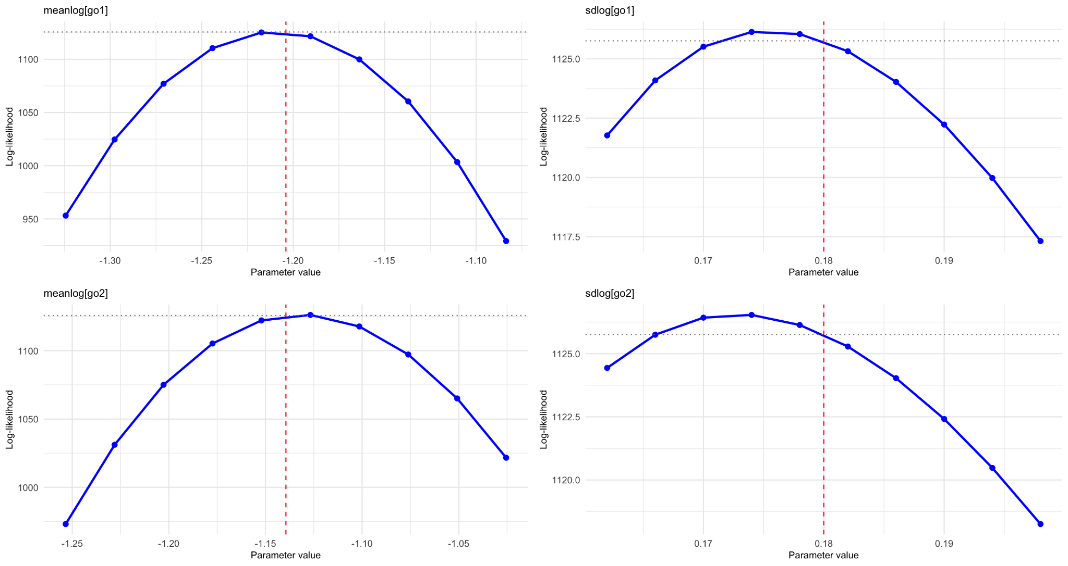
Profile plots
Define a set of true parameters
With those generate lots of data
Per parameter:
Take small perturbations around the true value of one parameter, keeping the others constant
Calculate the likelihood for these new values (it should be lower than the true value)
Do this for each parameter

Slide 6
Recovery
Define a set of true parameters
With those generate lots of data
Estimate the model on that data
It should return the true values!
Tells us about parameter trade-offs and unidentifiability

Slide 7
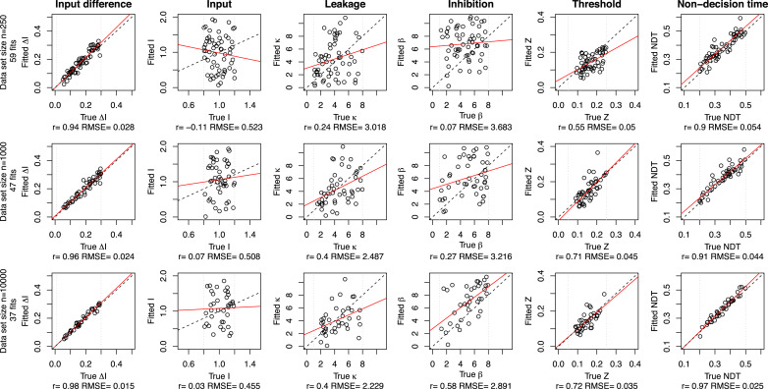
Recovery

Slide 8
SBC
Define a prior
Draw n parameter sets from this prior
Generate n data-sets from this prior
Estimate your Bayesian model (same prior) on these data-sets
The generating prior value for n, should equally likely fall in any percentile of posterior n
View the posterior as a probability distribution. The 1st percentile of a distribution, is equally likely as the 2nd, and the 50th etc. (definition of a percentile).
Identifies model and estimator misspecification!

Slide 9
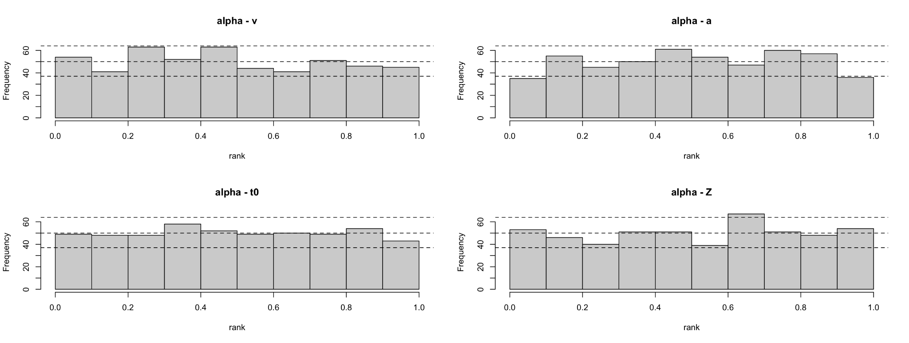
SBC
Plotting the percentiles/ranks of the prior on the posterior

Slide 10
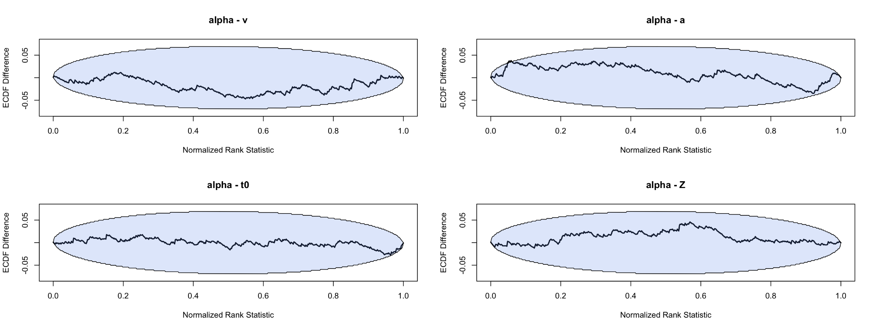
SBC
Bin width matters! Therefore ECDF plots
Difference between expected uniform ranks, and the observed uniform ranks

Slide 11
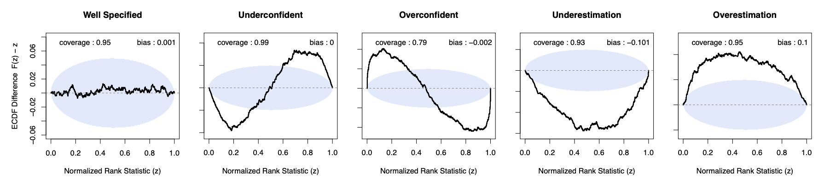
SBC

